Slide 1


ESSAY Question #2 ~ 5 TYPES OF ECOMMERCE BUSINESS
CIS 234E
Electronic Commerce
Website
Your Student ID
Your email address
Email to “DrV”
ProfessorVillegas@gmail.com
Place your pix above
And name below
Page 1
CIS 234E ~ ELECTRONIC COMMERCE WEBSITE * YOUR FULL NAME + Phone Number

Slide 2
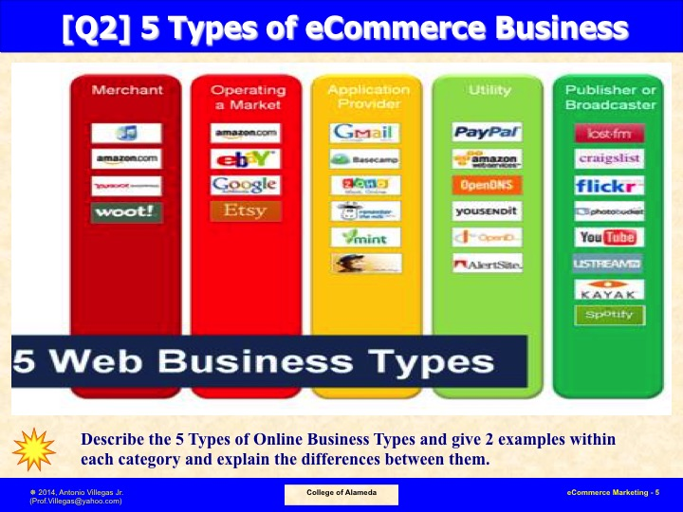
Page 2
CIS 234E ~ ELECTRONIC COMMERCE WEBSITE * YOUR FULL NAME + Phone Number

Slide 3
ESSAY Question 2 ~ Merchant Business (Example 1)
In very few words
Explain MERCHANT Business
And show
Company 1 as example
Place a picture depicting your answer above + short description here
Page 3
CIS 234E ~ ELECTRONIC COMMERCE WEBSITE * YOUR FULL NAME + Phone Number

Slide 4
ESSAY Question 2 ~ Merchant Business (Example 2)
In very few words
Explain MERCHANT Business
And show
Company 2 as example
Place a picture depicting your answer above + short description here
Page 4
CIS 234E ~ ELECTRONIC COMMERCE WEBSITE * YOUR FULL NAME + Phone Number

Slide 5
ESSAY Question 2 ~ Operating Market Business (Example 1)
In very few words
Explain OPERATING IN MARKET Business
And show
Company 1 as example
Place a picture depicting your answer above + short description here
Page 5
CIS 234E ~ ELECTRONIC COMMERCE WEBSITE * YOUR FULL NAME + Phone Number

Slide 6
ESSAY Question 2 ~ Operating Market Business (Example 2)
In very few words
Explain OPERATING IN MARKET Business
And show
Company 2 as example
Place a picture depicting your answer above + short description here
Page 6
CIS 234E ~ ELECTRONIC COMMERCE WEBSITE * YOUR FULL NAME + Phone Number

Slide 7
ESSAY Question 2 ~ Application Provider Business (Example 1)
In very few words
Explain APPLICATION PROVIDER Business
And show
Company 1 as example
Place a picture depicting your answer above + short description here
Page 7
CIS 234E ~ ELECTRONIC COMMERCE WEBSITE * YOUR FULL NAME + Phone Number

Slide 8
ESSAY Question 2 ~ Application Provider Business (Example 2)
In very few words
Explain APPLICATION PROVIDER Business
And show
Company 2 as example
Place a picture depicting your answer above + short description here
Page 8
CIS 234E ~ ELECTRONIC COMMERCE WEBSITE * YOUR FULL NAME + Phone Number

Slide 9
ESSAY Question 2 ~ Utiility Business (Example 1)
In very few words
Explain UTILITY Business
And show
Company 1 as example
Place a picture depicting your answer above + short description here
Page 9
CIS 234E ~ ELECTRONIC COMMERCE WEBSITE * YOUR FULL NAME + Phone Number

Slide 10
ESSAY Question 2 ~ Utiility Business (Example 2)
In very few words
Explain UTILITY Business
And show
Company 2 as example
Place a picture depicting your answer above + short description here
Page 10
CIS 234E ~ ELECTRONIC COMMERCE WEBSITE * YOUR FULL NAME + Phone Number

Slide 11
ESSAY Question 2 ~ Publisher/Broadcaster (Example 1)
In very few words
Explain PUBLISHER or BROADCASTER Business
And show
Company 1 as example
Place a picture depicting your answer above + short description here
Page 11
CIS 234E ~ ELECTRONIC COMMERCE WEBSITE * YOUR FULL NAME + Phone Number

Slide 12
ESSAY Question 2 ~ Publisher/Broadcaster (Example 2)
In very few words
Explain PUBLISHER or BROADCASTER Business
And show
Company 2 as example
Place a picture depicting your answer above + short description here
Page 12
CIS 234E ~ ELECTRONIC COMMERCE WEBSITE * YOUR FULL NAME + Phone Number

Slide 13
ESSAY Question 2 ~ Summary of your Answers
Summarize your answers with picture above + short description here
Page 13
CIS 234E ~ ELECTRONIC COMMERCE WEBSITE * YOUR FULL NAME + Phone Number

Slide 14
ESSAY Question 2 ~ Bibliographical References
Use MLA Citation for your Bibliography entries
~ go to this website for help
➔ https://www.refme.com/us/citation-generator/mla/
Page 14
CIS 234E ~ ELECTRONIC COMMERCE WEBSITE * YOUR FULL NAME + Phone Number

